Slide 1


LOAN STATUS PREDICTION
MIS 636 FINAL PROJECT
Presented by:
Chahak Chawrekar
Krati Bakliwal
Shristi Moryani
Ishank Sethi
Neil Shah

Slide 2

How did you define the problem?
In this Loan Status Prediction dataset, we have the data of applicants who previously applied for the loan based on the property which is a Property Loan.
The bank will decide whether to give a loan to the applicant based on some factors such as Applicant Income, Loan Amount, previous Credit History and Co-applicant Income.
Our goal is to build a Machine Learning Model to predict the loan to be approved or to be rejected for an applicant.

Slide 3

HOW DID YOU EXPLAIN THE BUSINESS PROBLEM?
In this project, we are leveraging the power of machine learning.
We've built a model that analyzes data on past loan applications, including factors like applicant income, loan amount, credit history, and co-applicant income.
By analyzing these factors in combination, our model can identify patterns that differentiate approved loans from rejected ones.
This allows us to predict the likelihood of future loan applications being successful, streamlining the process for both the bank and potential borrowers.

Slide 4
DATA SET
INPUT VARIABLES | DATA TYPE
Loan ID | Categorical
Gender | Categorical
Married | Categorical
Dependents | Numerical
Education | Categorical
Self-Employed | Categorical
Applicant Income | Numerical
Coapplicant Income | Numerical
Loan Amount | Numerical
Loan Amount Term | Numerical
Credit History | Numerical
Property Area | Categorical
The Dataset we used was Loan Data CSV file that was obtained through Kaggle.
Here is some basic information about the dataset.
12 variables (Input Variables)
“Loan Status” (Output Variable).

Slide 5

DATA CLEANING, PROCESSING AND ANALYSIS
Imported the dataset and libraries.
Described the dataset using the measurement of central tendency.
Created Visualizations for better Data Understanding.
Dropped variables with 0 variance and dropped the variables with high cardinality.
Extracted the numerical variables and then scaled them.
Then Standardized them so that they have a mean of 0 and a standard deviation of 1 to ensure that all features contribute equally to the analysis.
Performed One hot Encoding for categorial variables
Balanced the dataset.
Performed Variable Selection in Python using Correlation Analysis
Fitted these Models - Decision Tree, Random Forest, k-NN, Logistic Regression & Linear Regression.
Evaluated the Performance of each model using distinct performance indicators.

Slide 6
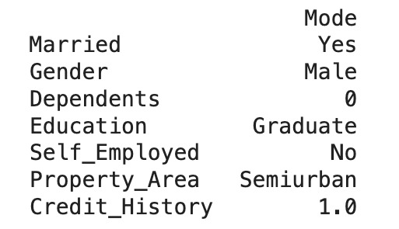
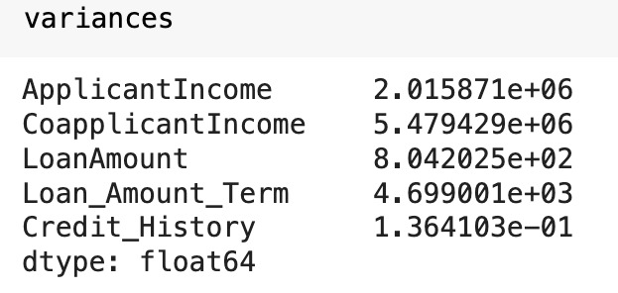
DESCRIPTIVE ANALYSIS
MODE
Number of Rows - 381
Number of Columns - 13
Number of NA Values – 75
Percent of missing values by columns
Gender – 1.31
Dependents – 2.09
Self-Employed – 5.51
Loan_amount_term -2.88
Credit history – 7.87
VARIANCE

Slide 7
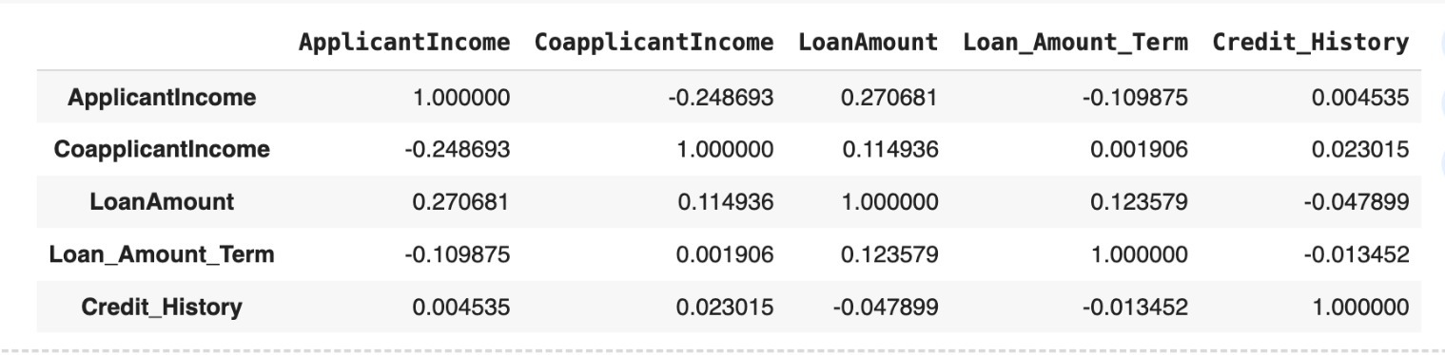
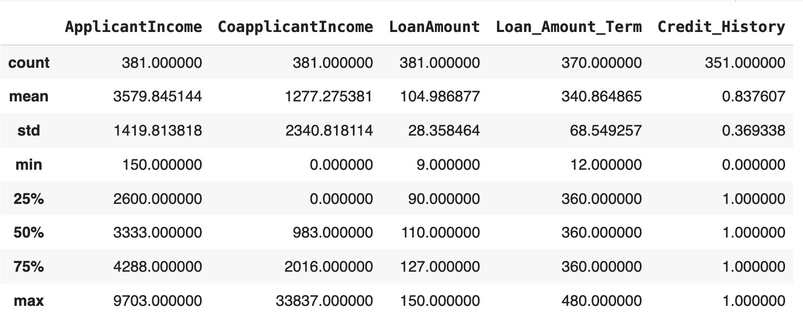
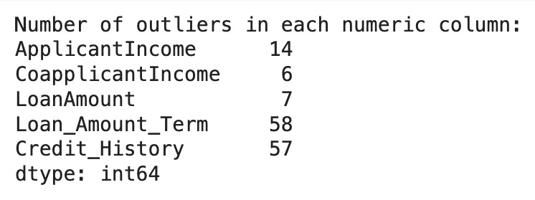
CORRELATION
DESCRIPTIVE STATISTICS
OUTLIERS

Slide 8
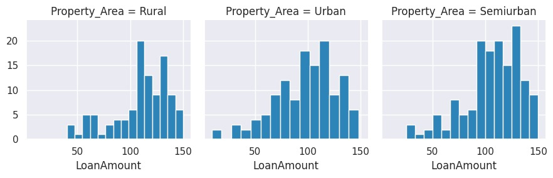
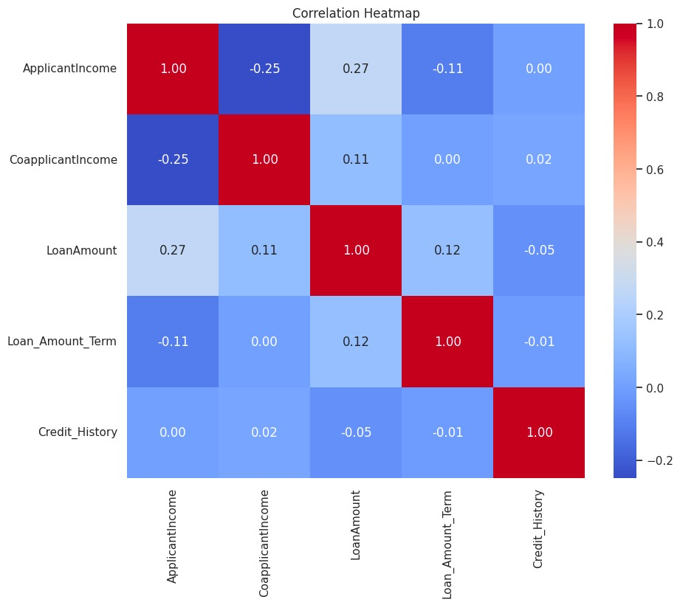
DATA VISUALIZATION
GROUPED HISTOGRAMS
HEATMAP

Slide 9
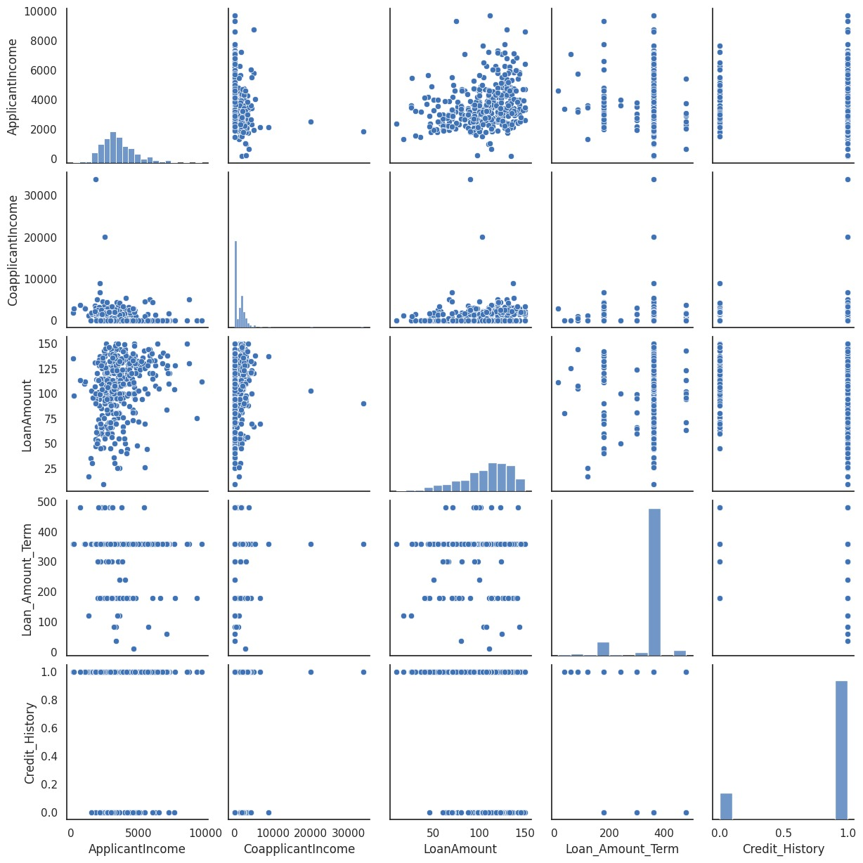
CORRELATION PAIR PLOT

Slide 10
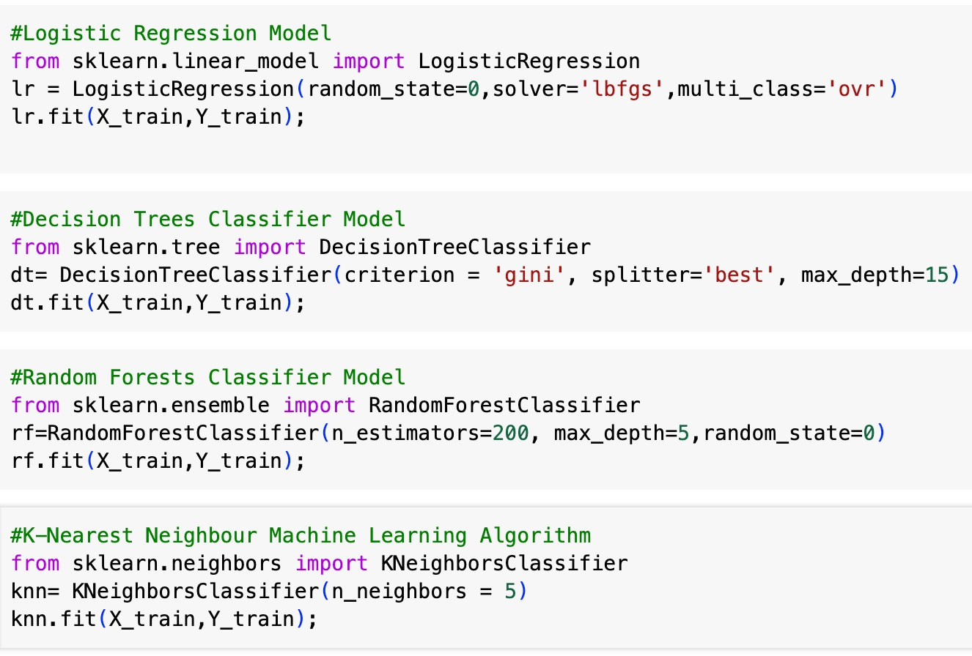
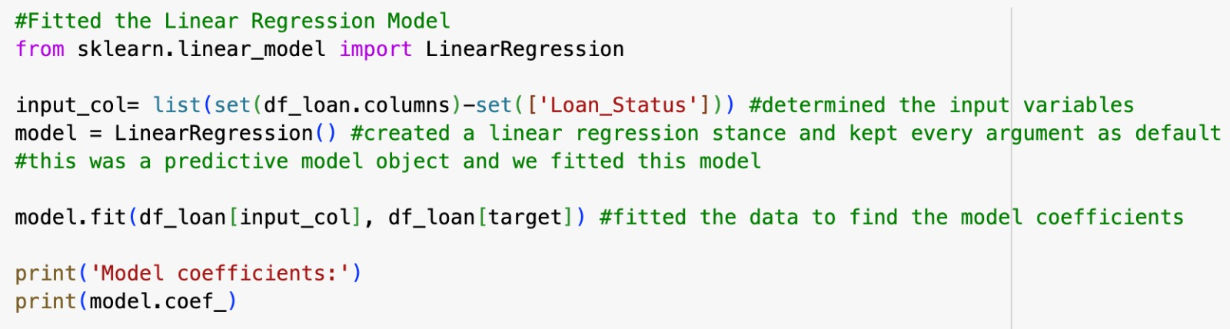
ALGORITHM AND MODEL
We ran the following models to see which one could best predict if an applicant is likely to receive a loan:
Logistic Regression
Decision Tree
Random Forest
KNN
Linear Regression

Slide 11
PARAMETERS OF ALGORITHM AND ITS REASONS FOR ALTERATION
The multi_class parameter ‘Ovr' of the logistic regression model helped us to fit a separate binary classification model for each class, to predict the probability of a loan being approved (positive class) or denied (negative class).
In the context of Decision trees, the criterion parameter ‘Gini’ helped us in measuring the probability of incorrectly classifying a randomly chosen element if it were randomly labelled according to the distribution of labels in the node and the ‘best’ splitter parameter helped our model to select the best split among all possible splits based on the chosen criterion.
For our Random Forest model, having more trees in the ensemble resulted in a better performance and robustness by reducing the variance of our model. Limiting the maximum depth helped us to prevent overfitting. And setting the random state ensured that same random numbers are generated every time the code runs.

Slide 12
For our k-nn algorithm, choosing n_neighbors = 5 helped us to make predictions based on the majority class among the 5 nearest neighbors, which is a commonly used approach as smaller values result in overfitting and larger values lead to a more rigid model with higher bias.
Reasoning for selecting default parameters for our linear regression model provided our model a reasonable starting point for most use cases. for instance, fitting an intercept (fit intercept=true) allowed our model to capture the mean value of the target variable when all predictors were zero.
After Alteration : When we tried to amend the parameter of our Decision Tree model by decreasing the maximum depth of each individual decision tree to 5, the accuracy of the model reduced. Whereas, when we increased the number of estimators for our Random Forest model to 200, the accuracy of the model surged.

Slide 13
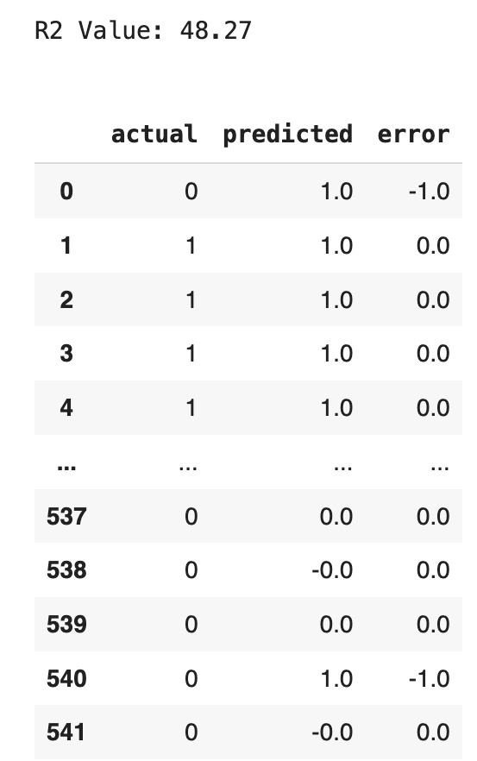
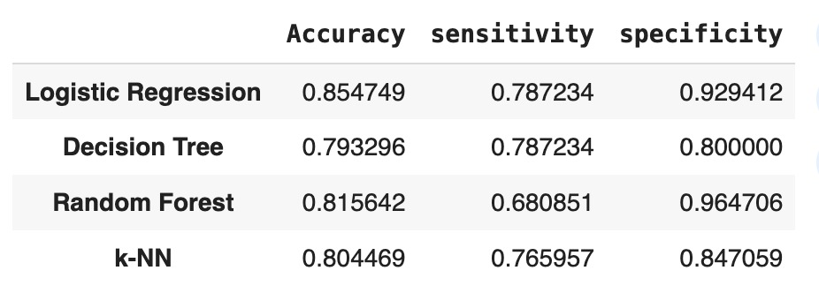
PERFORMANCE INDICATORS
For our Linear Regression Model, we used R2 as our performance indicator representing the proportion of variance of our target variable explained by all the input variables. We also calculated the error by subtracting the Predicted values from the Actual values to assess the performance of our model.
After creating and running the rest of the models, we produced a data frame that displayed the accuracy, sensitivity and specificity of each model to compare the models easily.

Slide 14
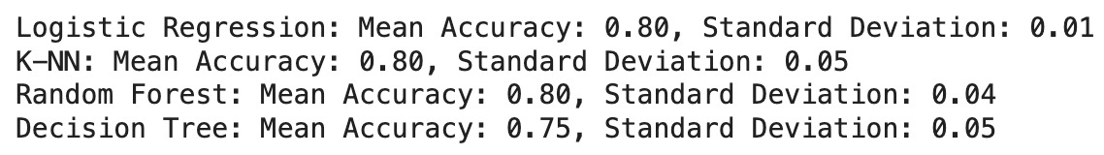
Additionally, we used cross-validation to estimate how well each model is expected to perform on unseen data by acquiring mean accuracy and standard deviation.
The performance indicator of the learning algorithm improved after feature selection for linear regression, as witnessed by the increase in the R2 value suggesting that the selected features better explain the variance in the target variable compared to using all features. However, the performance of other learning algorithms remained the same, indicating that they might not have been as sensitive to feature selection.

Slide 15
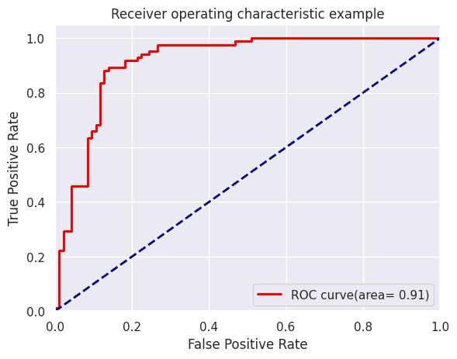
RESULTS
When we examined the results, we saw that the Logistic Regression model was the most accurate one, with an accuracy of 0.8547, higher than the other models.
Additionally, the resulting mean accuracy from cross-validation (0.80) is consistent for all the models, but a lower standard deviation of the Logistic Regression Model indicates more consistent performance across different folds.
We can see from the ROC curve that the Logistic Regression model would help us most accurately predict which applicant would be applicable for the loan.

Slide 16

THANK YOU !

